Slide 1
Disksim Simulator Environment Quick Guide
In The Name of God
Data Storage Systems and Networks Libratory
Sharif University of Technology
http://dsn.ce.sharif.edu
Farzaneh Rajaei Salmasi
rajaei@ce.sharif.ir

Slide 2
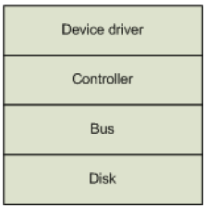
What is Disksim
Accurate, Highly-Configurable storage sub system simulator.
Disk-simulation environment from Carnegie Mellon University.
Emulates a hierarchy of storage components such as buses and controllers (e.g. RAID arrays) as well as disks.

Slide 3
What is Disksim (Cont.)
Can be integrated into full system simulators as a disk model
Mostly is used for performance evaluation
Cache support only for disks
No energy evaluation model

Slide 4
SSD Extension
SSD Extension for Disksim from Microsoft Research
Patched over Disksim
No documentation
No cache support
Page map FTL
Interleaving
Cleaning and Wear leveling

Slide 5
Disksim Inputs and Output
Driven by externally-provided I/O request traces or internally-generated synthetic workloads.
Parameter file (.parv)
Details of architecture
A diskspec or model for disks
An Output file (.outv)
Response Time
Number of reads and writes

Slide 6
Installation & Run
DiskSim is devloped in Linux environment
Just need a make command to install
~/disksim-4.0$ make
Running Disksim
disksim <parfile> <outfile> <tracetype> <tracefile> <synthgen>
<parfile> : parameter file, <outfile> : output file
<tracetype> : format of input trace file
<tracefile> : trace file used as inuput
<synthgen> : activate synthetic workload generator
Example
$./disksim ssd-sr250k.parv ssd-sr250k.outv ascii 0 1
$./disksim ssd-sr250k.parv ssd-sr250k.outv ascii sample.trace 0

Slide 7
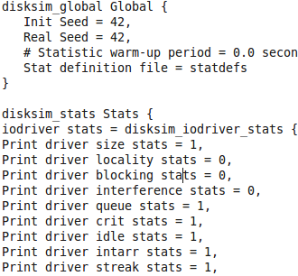
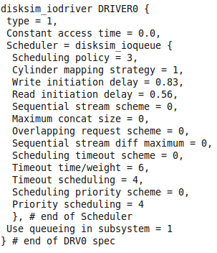
Parameter file

Slide 8
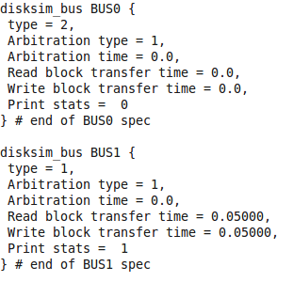
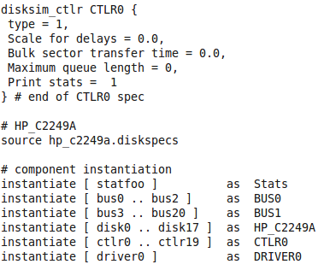
Parameter file (Cont.)

Slide 9
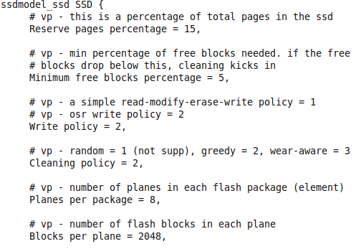
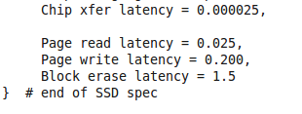
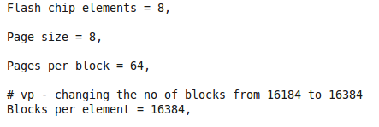
Parameter file (Cont.)

Slide 10
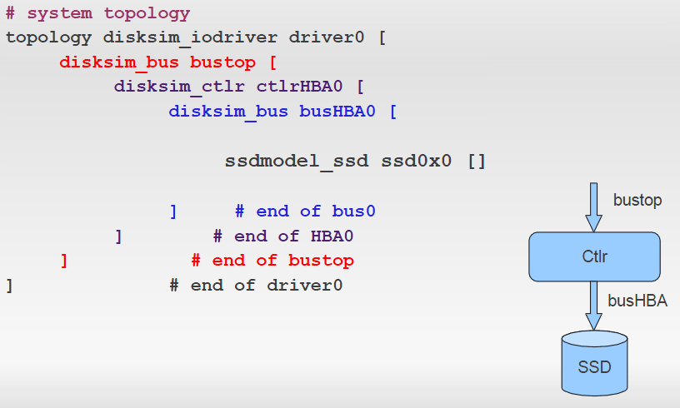
Parameter file (Cont.)

Slide 11
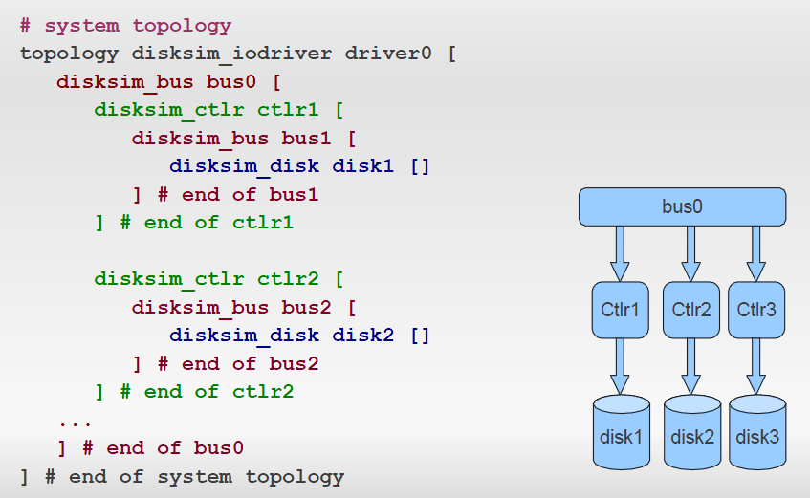
Parameter file (cont.)

Slide 12
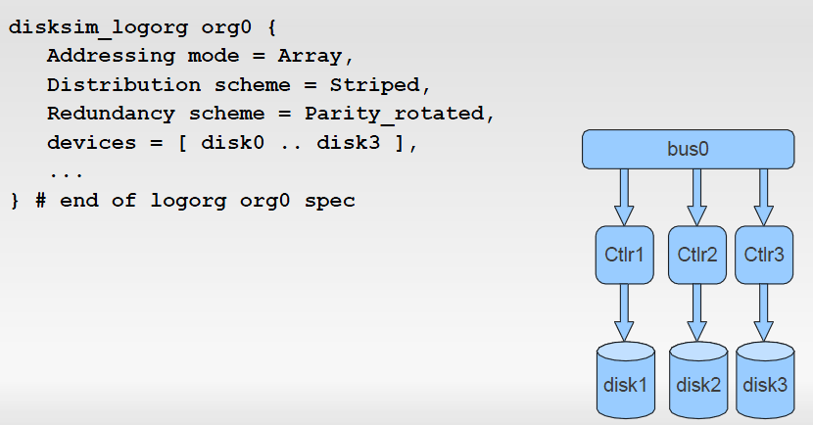
Parameter file (cont.)

Slide 13
Input Workload
Traces
<time>:<N/A>:<Block_addr>:<#following_block>:<R/W>
8351.254 0 44224696 128 0
8361.202 0 9227496 8192 0
8398.347 0 9235688 3768 1
8398.347 0 9235688 3768 0
...
Synthetic Workloads
Highly configurable
Multiple generator
Each synthetic execute as a process

Slide 14
Simulation Result
Statistical Results in different layers
Logical Organization Statistics
#read/write
#seq. read/write
I/O Driver Statistics
Idle time
Response time
Throughput (newly added)
Disk/SSD Statistics
Idle time
Response time
IOPS
# Cleaning for SSD chips

Slide 15
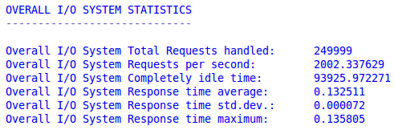
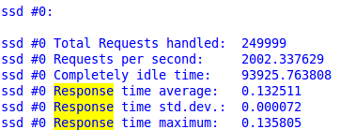
Simulation Result (cont.)

Slide 16
Demonstration
Download DiskSim From DSN homepage
Extract package
Make
Run
Dive in Code with Kdevelop

Slide 17
Demonstration
Execution file
~/disksim-4.0/src/disksim
Common Codes (before disk level)
Source Code: ~/disksim-4.0/src/…
For disk
Parv and trace files: ~/disksim-4.0/valid/…
Source Code: ~/disksim-4.0/diskmodel/…
For SSD
Parv and trace files~/disksim-4.0/ssdmodel/valid/…
Source code: ~/disksim-4.0/ssdmodel/…

