Slide 1
mrFPGA: A Novel FPGA Architecture with Memristor-Based ReconFIguration
Ali Ahari
Data Storage Systems and Networks Lab.
October 2011

Slide 2
Outline
Introduction
Ideas
Evaluation
Conclusion

Slide 3
Introduction
We are going to talk about mrFPGA a paper by Jason Cong and Bingjun Xiao from UCLA which has been appeared in NanoArch 2011

Slide 4
Main Ideas
Using memristor in configuration bits
No need for 3D-Die stacking
Capacitance shielding
Adaptive buffer insertion
New CAD software

Slide 5
Memresistor in RC
Scalable below 30nm
Fully compatible with CMOS
Programming time 5ns in 180nm Tech.

Slide 6
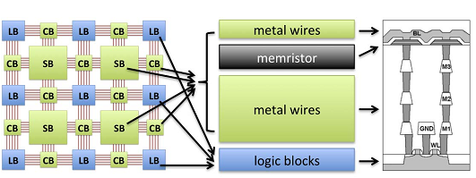
Architecture

Slide 7
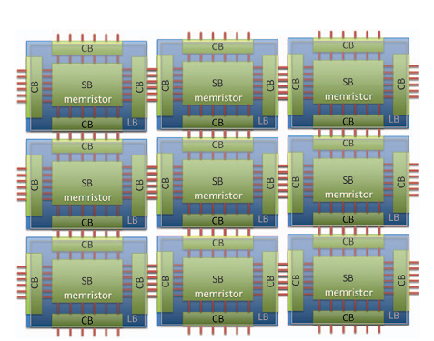
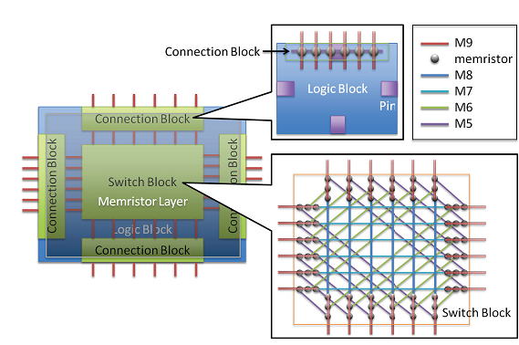
Architecture

Slide 8
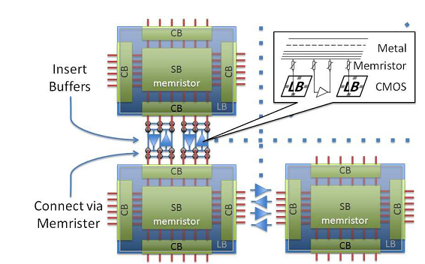
Adaptive buffer insertation

Slide 9
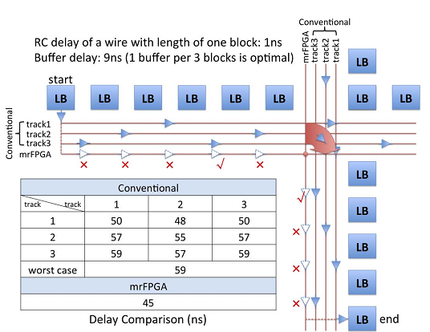
ABI

Slide 10
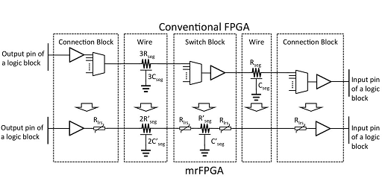
Modeling delay

Slide 11
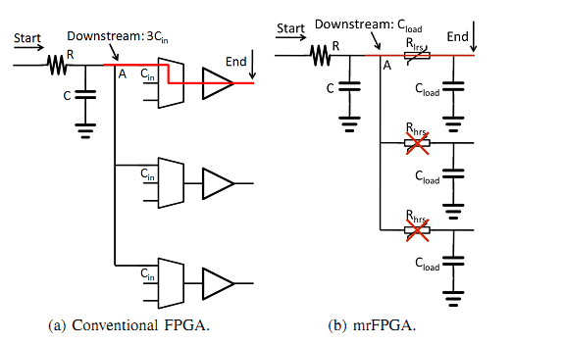
Shielding Effect

Slide 12
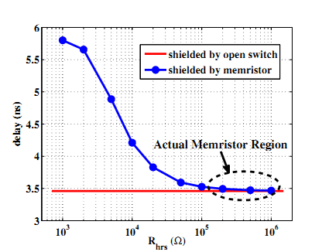
Shielding Effect

Slide 13
Area Comprassion

Slide 14
Evaluation
Against Virtex 6
20 MCNC benchmarks
5.18x area savings
2.28x speed-up
1.63x power savings

Slide 15
Conclusion
Not a new approach

