Slide 1
Hystor: Making the Best Use of Solid State Drives in High Performance Storage Systems
Feng Chen, David Koufaty Xiaodong Zhang
Circuits and Systems Research Dept. of Computer Science & Engineering
Intel Labs The Ohio State University
ICS '11 Proceedings of the international conference on Supercomputing

Slide 2
Introduction
High-performance storage systems are still built on conventional hard disk drives (HDDs)
low random access performance
high power consumption
Gordon
San Diego Supercomputer Center
256TB of flash memory storage
backed by $20 million fund!

Slide 3
Introduction
SSD is nearly 10 times more expensive than HDD
SSD is not a replacement for HDD
SSD can be used as a secondary-level cache
Between DRAM and HDD
LRU?

Slide 4
Which blocks should be cached?
Sequential vs. Random
Reading a big file
Most performance-critical blocks
Filesystem metadata

Slide 5
Hystor
Hybrid storage system
Integrates SSD and HDD as a single block device
Minimum changes to OS kernel
Implemented as a kernel module
Write-back buffer

Slide 6
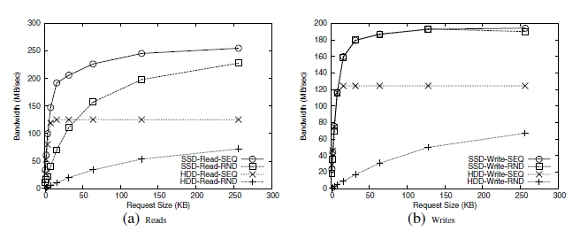
Sequential vs. Random

Slide 7
Identifying High-Cost Blocks
Measure I/O latency of accessing each block
Use the accumulated latency as ‘cost’ of each block
Measure latency in SSD?
Another pattern-related metric like latency
Request size
Frequency
Seek distance
Reuse distance

Slide 8
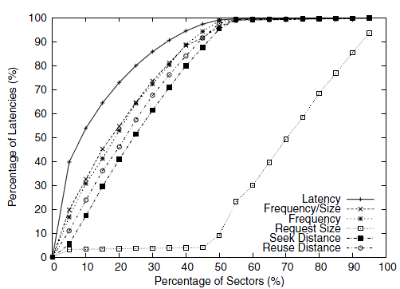
Identifying High-Cost Blocks
$\frac{Freq. }{Req. Size }$

Slide 9
Identifying Metadata Blocks
Before accessing a file, its metadata blocks must be loaded into memory
Static metadata detection
File systems like ext3 /ext4 tag metadata blocks for I/O scheduler

Slide 10
Maintaining Data Access History
Three-level table
Block Global Directory (BGD)
Block Middle Directory (BMD)
Block Table Entry (BTE)
Each BGD or BMD entry has a 32-bit pointer field pointing to a (BMD or BTE) page in the next level
Each BTE entry has a 16-bit counter field and a 16-bit flag field

Slide 11
Representing Indicator Metric
inverse bitmap
$b = 2^{max⁡(0,7−\left\lfloor \log_{2}{N}\right\rfloor )}$
At each level the counter of the corresponding entry incremented by b
shift all the counters of the entries in the same entry page by one bit in case of overflow

Slide 12
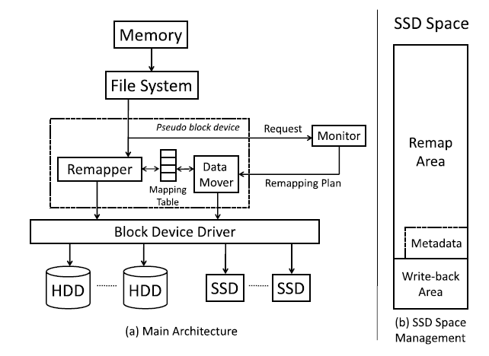
Design of HYSTOR
Remapper
Monitor
Data mover

Slide 13
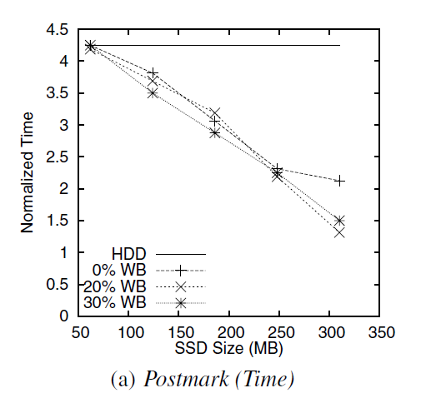
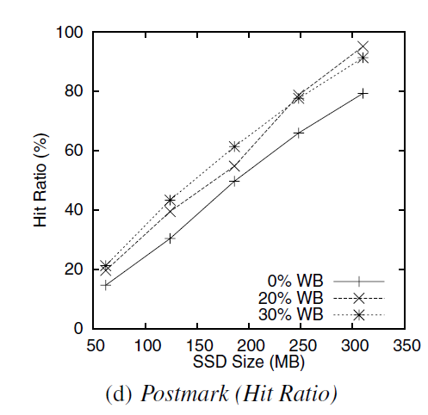
Performance of Hystor

Slide 14
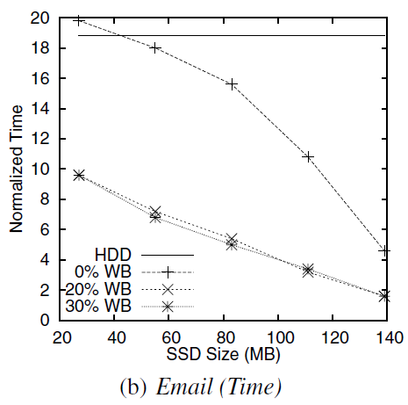
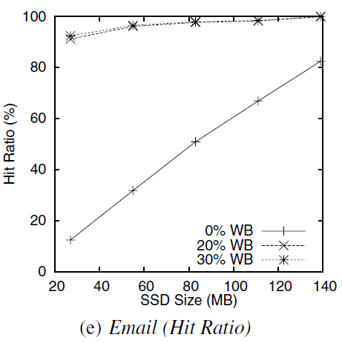
Performance of Hystor

Slide 15
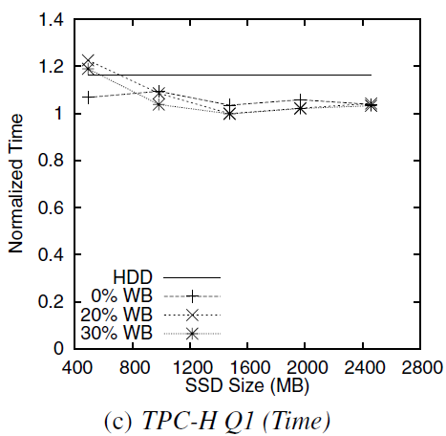
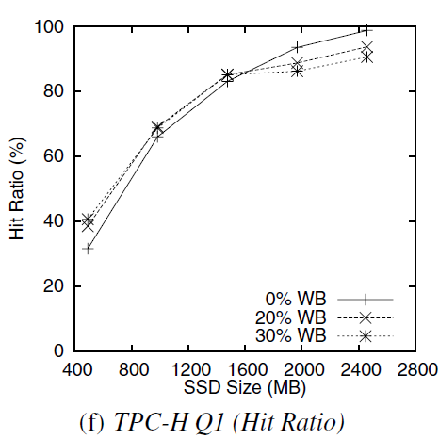
Performance of Hystor

Slide 16
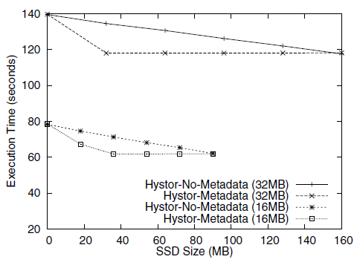
Caching metadata requests
Intel® Open
Storage Toolkit
Ext3 filesystem
32GB file

Slide 17
Azor: Using Two-level Block Selection to Improve SSD-based I/O caches
Yannis Klonatos, Thanos Makatos, Manolis Marazakis, Michail D. Flouris, and Angelos Bilas
Foundation for Research and Technology - Hellas (FORTH), Institute of Computer Science (ICS)
2011 Sixth IEEE International Conference on Networking, Architecture, and Storage

Slide 18
Important factors
Cache associativity
Two-level block selection scheme
Write-handling policies

Slide 19
Cache associativity
Fully-set-associative
Requires 6.04 MB of metadata per GB of SSD
Use Robert Jenkins’ 32-bit integer hash function
Direct-mapped
Requires 1.28 MB of metadata per GB of SSD

Slide 20
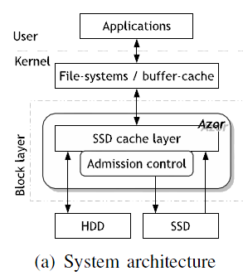
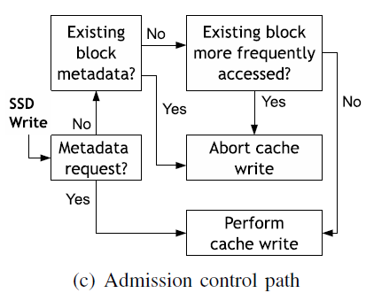
Design of Azor

Slide 21
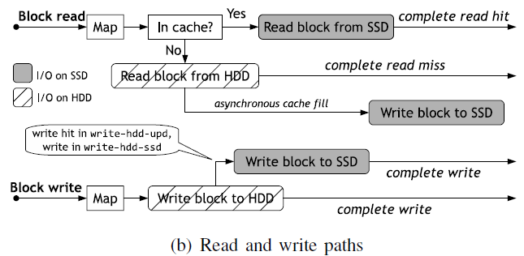
Design of Azor

Slide 22
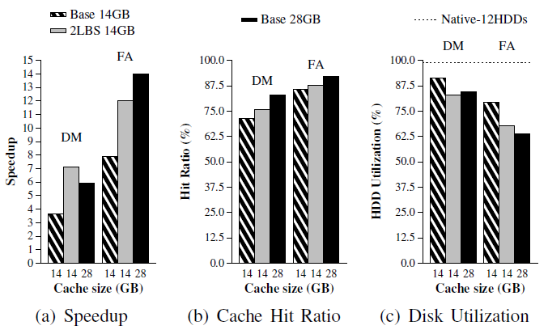
Experimental Results

Slide 23
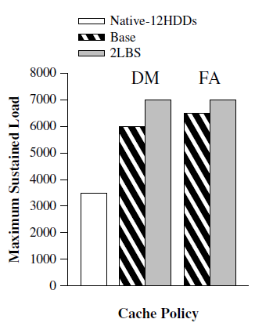
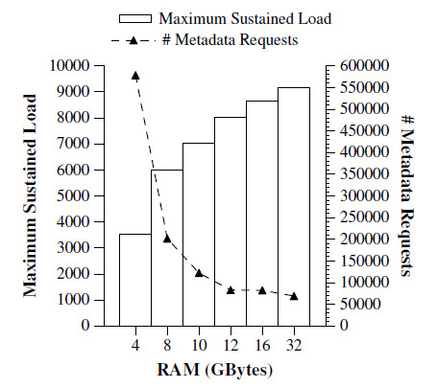
SPECsfs2008

Slide 24
Write policy affect

Slide 25
?

