Slide 1
Power Model
Kaveh Ramezani (kaveh.ramezani@gmail.com)
Dsn.ce.sharif.edu

Slide 2
introduction
Needs for energy reduction schemes in storage systems:
Power management strategies
Switch to lower power modes in idle prides.
Lower rotation speed (in multispeed disks)
Head unload (some Toshiba disks)
Standby
Sleep

Slide 3
introduction
Needs for energy reduction schemes in storage systems:
Estimate Energy consumption
Implementation on a real model
Problems
Cost (Accurate and high-speed power meters)
Analyze problems
Simulation
Dempsey
Adaptive power management
Stamp
State-based power model (DR. manzares)

Slide 4
introduction
Adams power model:
Implemented on disksim.
Adds standby power management simulation to disksim
Has some problems
Inaccurate energy consumption
Destroys access time

Slide 5
Power management scheme
Start serving an I/O request
Disksim regular states:
Idle phase:
Platters rotate in max speed
Active phase:
Platters rotate in max speed
Additional activities to serve IO requests
Seek
Latency
xfer
Idle
Active
end serving an I/O request

Slide 6
Power management scheme
Start serving an I/O request
Power management scheme:
States:
Idle phase
Active phase
Standby phase
Spindle motor turns off
Other parts are active
If (idle-time > break event time)
Go to standby state
Idle
Active
end serving an I/O request
Idle time>BET
Standby
Cache miss

Slide 7
Power management scheme
Start serving an I/O request
Start serving an I/O request
Problems:
Plotter rotation stop/start
Time overhead.
Energy consumption penalty
Solution:
middle states:
Spin-up state
Spin-down state
Active
Idle
Active
Idle
end serving an I/O request
end serving an I/O request
Idle time>BET
Idle time>BET
Cache miss
Spin-down
Standby
Spin-up
Standby
Cache miss

Slide 8
Power management scheme
Implementation details:
Timer
Spin-down
Sleep
Spin-up
Start serving an I/O request
Idle
Active
end serving an I/O request
Idle time>BET
Spin-down
Spin-up
Standby
Cache miss

Slide 9
Power management scheme
Implementation details:
Timer
Use IdleTimerExpired
calculate idle interval time
If (idle time> BreakEvenTime)
Initiate Standby state
(call spin-down function)
Start serving an I/O request
Idle
Active
timer
end serving an I/O request
Idle time>BET
Spin-down
Spin-up
Standby
Cache miss

Slide 10
Power management scheme
Implementation details:
Spin-down
disk status: DISK_SPIN_DOWN
Add spin-down energy to TotalTransEnergy
Make new event and add to queue
Type: SPIN_DOWN_COMP
Time: current time + spin-down time
When this event arrives
Disk status: DISK_STANDBY
Start serving an I/O request
Idle
Active
timer
end serving an I/O request
Idle time>BET
Spin-down
Spin-up
Standby
Cache miss

Slide 11
Power management scheme
Spin-up
Wakeup-Disk-Sleep
Wakeup_Disk_SpinDown
Wakeup-SpinUp
Start serving an I/O request
Idle
Active
end serving an I/O request
Idle time>BET
Spin-down
Spin-up
Standby

Slide 12
Power management scheme
Spin-up
Wakeup-Disk-Sleep
Change disk state to DISK_SPIN_UP
Add spin-up energy to TotalTransEnergy
Add sleep time to TotalSleepTime
Make new event
Type: SPIN_UP_COMP
Time: CurrTime+SU time
Return delay time
Start serving an I/O request
Idle
Active
end serving an I/O request
Idle time>BET
Spin-down
Spin-up
Standby
Cache miss

Slide 13
Power management scheme
Spin-up
Wakeup_Disk_SpinDown
Change disk mode directly to DISK_SPINUP
Add spin-up energy to TotalTransEnergy
Make new event
Type: SPIN_UP_COMP
Time: S-D-Com + spin-up-time
Return spin_up_time as delay
Start serving an I/O request
Idle
Active
end serving an I/O request
Idle time>BET
Spin-down
Cache miss
Spin-up
Standby

Slide 14
Power management scheme
Spin-up
Wakeup-Disk-SpinUp
Return delay
Delay=SU_Com – currtime
Start serving an I/O request
Idle
Active
end serving an I/O request
Idle time>BET
Cache miss
Spin-down
Spin-up
Standby

Slide 15
Power management scheme
Important challenge:
When to call spin-up functions?
in bus delay calculation function(Add spin-up/down overhead time to bus delay)?
Problems:
Inaccurate rotational latency
Neglect internal buffer hit
When i/o request arrives?
Discard current req
Make a new i/o req-event
time= previous req-event time + delay
Problem: neglect internal buffer hit
After buffer miss and Before access phase( before initiate seek function)

Slide 16
Energy consumption Measurement
Energy calculation methodology
Estimate time of each state
Each state energy consumption= state total time * state power
States:
Sleep
Spin down
Spin up
Active
idle

Slide 17
Energy consumption Measurement
Active state:
Disksim active models.
Constant mode
Accurate mode
contains three stages:
Seek
Rotational latency
xfer

Slide 18
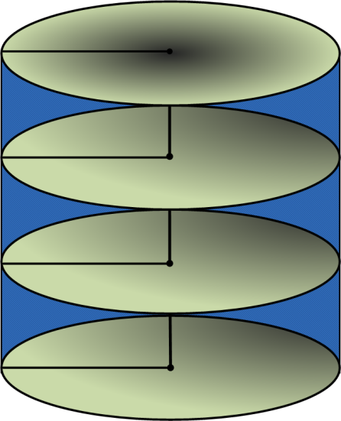
Energy consumption Measurement
Active state:
Seek
Seek time =Max (HeadSwitchTime , SeekTime) + Write SettleTime

Slide 19

Energy consumption Measurement
Active state:
Rotational latency
$Currtime = simtime + seektime$
$S = currtime − (PowerManEffect)$
$PowerManEffect=−½\left(TransTime\right)+ TransTime+ standbyTime$
$BPT= Res =s \% RotateTime$
$APT = \left(\frac{FirstSectorNum}{TrackSectors}\right)∗ RotateTime$
$Rotational latancy = APT − BPT$
BPT
0 sector
APT

Slide 20
Energy consumption Measurement
Active state:
Xfer
$$Xfer time= req_size/ sectors ∗ RotatetTme$$
0 sector
sector 0

Slide 21
Energy consumption Measurement
Idle state:
Add distance between two requests to Total Idle Time variable
Idle time = EndSimTime - (TotalActiveTime + TotalSleepTime + TransTime)

Slide 22
Simple example:
power | type
10.2w | Idle power
13.5w | Active Power
13j | SpinDown energy
135j | SpinUp energy
2.5w | Sleep power
1500ms | SpinDown time
10900ms | SpinUp time
$Total energy=\left(5500∗10.2\right)+13 +(2000∗2.5) +135+active time$
R/W | Req_size | Bck_num | Dev_num | Time
1 | 20 | 70000 | 0 | 9000
Idle Time=5500
SD_TIme=1500
Sleep:2000
SU_TIme=10900
Active
time
t=5500
T=7000
Req_time
=9000
T=19900

Slide 23
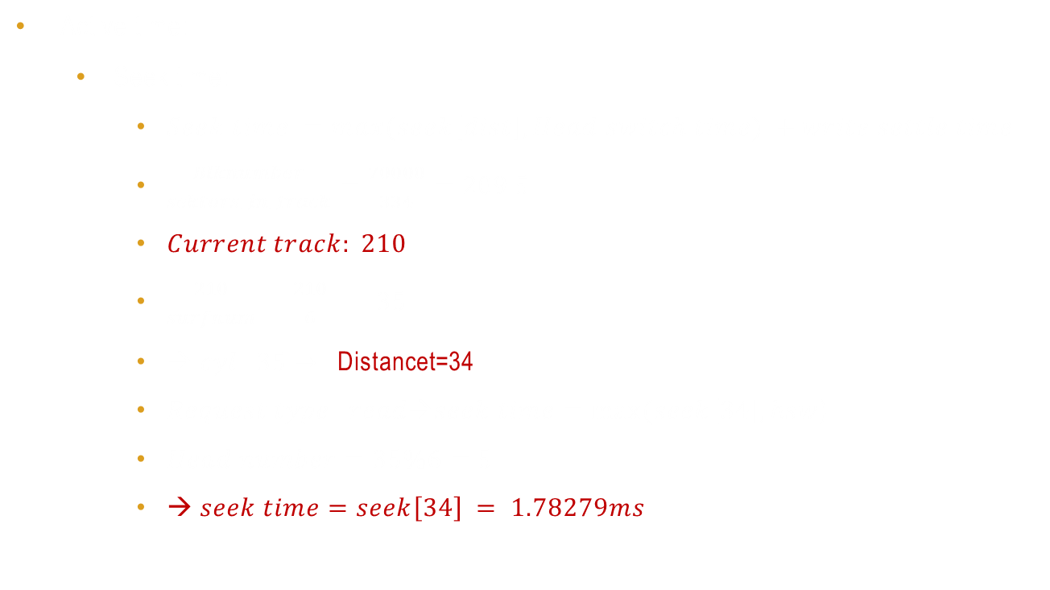
Simple example:
Active time:
Seek time:
$Seek time =max(seek\left[dist\right],Head switch time) +write settle time$
$\frac{Blknumber}{sektors_in_track}=\frac{70000}{334}=209.5$
$Current track: 210$
$\frac{210}{surfnum}=\frac{210}{6} = 35$
$→ cyl: 35→$ Distancet=34
$Request type: read→seek time=max⁡(seek\left[34\right], hsw$)
$Head number=35\%6=5$
$→ seek time=seek\left[34\right] = 1.78279ms$
6 | Surfnum
extracted | Seek Type
0.487 | Settling delay
0.176 | headSwitchTime
334 | Sectors per track

Slide 24

Simple example:
Active time:
Rotate time
$Current time= simtime+seek time=19901.78279$
$S=Current time − \left(\frac{1500+10900}{2}+2000\right)=11701.782$
$Before position time:$
$Rotate time=\frac{60000}{10025}=5.985037$
$BPT=19901.840 \% rotate time =1.03$4660
$after position time:$
$Current sector in track=\left(70000\%334\right)+1= 195$
$APT=\frac{195}{334} ∗5.985037=3.494258$
$Rotate Time= APT−BPT=2.459598$
100025 RPM | Speed
BPT
0 sector
APT

Slide 25

Simple example:
Active time:
Xfer time:
begin: 195
End: 215
→ requested sectores are in one sector
$Xfertime= \frac{requestSize}{334}∗rotationTime$
$$Xfertime=\frac{20}{334}∗5.98503$$
$$Xfertime=0.385$$
begin
0
End

Slide 26

Simple example:
$Active time = seek time + rotate time + xfer time$
$Active time =1.78279 + 2.440 + 0.385=4.608$
$Active energy = active time ∗ active energy =4.6 ∗ 13.5 = 62.1$
$$Total energy=\left(5500∗10.2\right)+13000 +\left(2000∗2.5\right)+135000+62.1$$
$$Total energy=208,983.512 mj$$
$$disksim result=209187.512 mj$$
(disksim idle time=5502)

