Slide 1
Different Mapping Schemes
Presentation for DSN Group Meeting
By: Reza Faridmoayer
Supervisor: Dr. Asadi
Sharif University of Technology, Department of Computer Engineering
Jun 28, 2011

Slide 2
Outline
Page-Level Mapping Scheme
Demand-based Flash Translation Layer (DFTL)
Convertible Flash Translation Layer (CFTL)
Block-Level Mapping Scheme
Hybrid-Level Mapping Scheme
Fully Associative Sector Translation (FAST)
Flexible group-mapping _{(the second presentation)}

Slide 3
Outline (cont.)
Hybrid-Level Mapping Scheme (Cont.)
Locality Aware Sector Translation (LAST)
Log-based Flash Translation Layer (LogFTL)
Switchable Address Translation (SAT) _{(next presentation)}
Filtering Flash Translation Layer (FFTL) _{(next presentation)}

Slide 4
Page-Level Mapping Scheme
Managing the NAND flash memory on page basis
A page mapping table:
Logical Page Numbers (LPNs)
Physical Page Numbers (PPNs)
Maintaining page mapping table in both RAM and NAND flash memory
Advantage
Good read/write performance because of its high block utilization

Slide 5
Page-Level Mapping Scheme (cont.)
Disadvantages
Increasing the number of invalid pages dramatically reducing the performance
A very large space in both RAM & NAND flash memory to store the original page table
The example of page-level mapping

Slide 6
Page-Level Mapping Scheme (cont.)

Slide 7
Demand-based Flash Translation Layer (DFTL)
A new mapping scheme
Storing the entire mapping table on flash memory instead of SRAM
Cache the most recently used mappings information
DFTL Architecture
Cached Mapping Table (CMT)
Global Translation Directory (GTD)

Slide 8
DFTL Architecture

Slide 9
Demand-based Flash Translation Layer (DFTL) (Cont.)
Advantages
The high utilization of the blocks space
Better write performance than hybrid-level mapping scheme under write dominant workloads
Removes the full merge operations
Disadvantages
Consideration temporal locality for data access
Suffering from the frequent updates of translation pages for write-intensive workloads

Slide 10
Demand-based Flash Translation Layer (DFTL) (Cont.)
The example of DFTL

Slide 11
Convertible Flash Translation Layer (CFTL)
A workload behavior FTL scheme
Takes advantage of page-level and block-level mapping scheme
Page-level and block-level mapping schemes to manage write-intensive workloads and read-intensive workloads
CFTL Architecture
Cached Block Mapping Table (CBMT)
Cached Page Mapping Table (CPMT)
Tier-1 Page Mapping Table

Slide 12
CFTL Architecture

Slide 13
Convertible Flash Translation Layer (CFTL) (Cont.)
DFTL and CFTL comparison

Slide 14
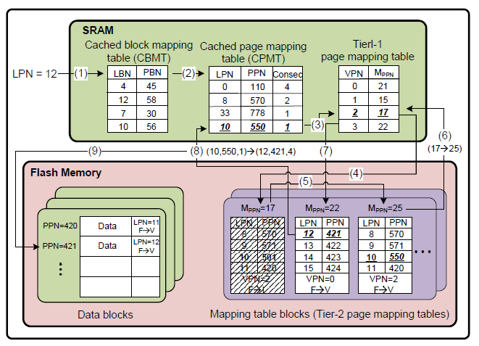
Convertible Flash Translation Layer (CFTL) (Cont.)
The example of CFTL

Slide 15
Block-level Mapping Scheme
Managing the NAND flash memory on block basis
A block mapping table:
Logical Block Numbers (LBNs)
Physical Block Numbers (PBNs)
Maintaining block mapping table in both RAM and NAND flash memory
Advantage
Smaller space of RAM and NAND flash

Slide 16
Block-level Mapping Scheme (Cont.)
Disadvantage
The block copy overhead
The example of block-level mapping scheme

Slide 18
Hybrid-Level Mapping Scheme
Managing the NAND flash memory on both page & block basis
Three types of mapping tables
Log Block Map Table
Block Map Table
Free Block Map Table
Maintaining the mapping tables in both RAM and NAND flash memory

Slide 19
Hybrid-Level Mapping Scheme (Cont.)
Advantage
Utilization both page-level and block-level mapping together
Disadvantage
Utilization full merge operation during garbage collection mechanism
The Inappropriate utilization of the log blocks space
The example of hybrid-level mapping scheme

Slide 21
Hybrid-Level Mapping Scheme (Cont.)
Fully Associative Sector Translation (FAST)
Utilization a log block by all of the data blocks
Allocation one special log block for sequential writes
Advantage
The optimal utilization of the log blocks space
Disadvantage
suffering from longer merge operation time

Slide 22
Hybrid-Level Mapping Scheme (Cont.)
Fully Associative Sector Translation (FAST)
Utilization a log block by all of the data blocks
Allocation one special log block for sequential writes
Advantage
The optimal utilization of the log blocks space
Disadvantage
suffering from longer merge operation time

Slide 23
Hybrid-Level Mapping Scheme (Cont.)
Locality Aware Sector Translation (LAST)
Classification random & sequential writes
Division the log blocks:
Random log blocks
Sequential log blocks
Storing the sequential & random writes into the sequential and random log blocks, respectively

Slide 24
Hybrid-Level Mapping Scheme (Cont.)
Locality Aware Sector Translation (LAST)
Advantage
Reduction full merge operations the improvement of performance

Slide 25
Hybrid-Level Mapping Scheme (Cont.)
Log-based Flash Translation Layer (LogFTL)
The utilization of some log blocks for each data block
The utilization of a pagemap cache to manage the pagemaps of entire logic blocks
Advantage
Shows the better performance than previous hybrid-level mapping schemes for read, write and erase operations
The example of LogFTL

Slide 26
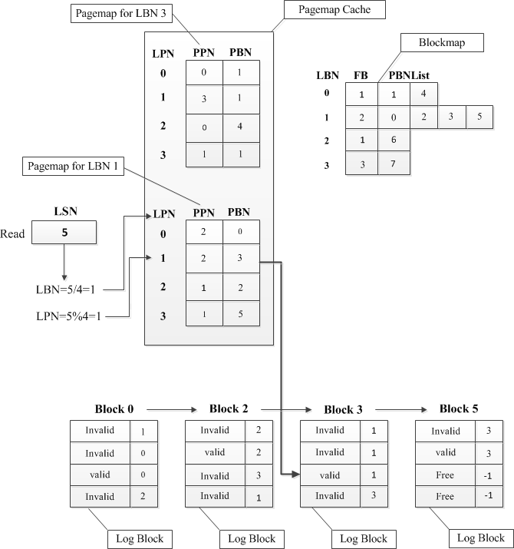

Slide 27
THANK YOU FOR YOUR ATTENTION
?

