Slide 1
A New I/O Scheduler for Solid State Devices
Amirali Shambayati
Mehrnoosh Sameki
Under Supervision of : Prof. Asadi
DSN Laboratory Research Work

Slide 2
INTRODUCTION
Read speeds of flash drives are much faster than traditional disks
Write speeds especially random write speeds, may not have such a clear advantage in performance

Slide 3
Flash Translation Layer(FTL)
Flash drives also employ a Flash Translation Layer (FTL) which can have unforeseen effects on drive performance.
Most SSDs employ copy-on-write mechanisms
Remap blocks through the Flash Translation Layer (FTL).
Different devices employ different policies at the
FTL level for remapping blocks, garbage collection and erase operations.

Slide 4
Why to change current I/O schedulers?
Current I/O schedulers take seek time, rotational latency overheads of magnetic disk drives into account in scheduling requests
The current schedulers may not adequately schedule requests for SSDs.

Slide 5
What they have done?
Proposing a framework for extracting important device parameters which will allow to redesign parts of the I/O subsystem to enhance performance.
Proposing a new I/O scheduler design which will order writes more efficiently on the flash drive and result in increased throughput for many workloads.

Slide 6
I/O Schedulers Developed for HDD
In traditional hard drives,
writing or reading from nearby physical sectors is far less expensive than reading from distant sectors due to the expensive seek operations involved.

Slide 7
I/O Schedulers Developed for HDD
So, I/O schedulers strive to reduce seek time and handles reads and writes to minimize head distance travelled.
more advanced I/O schedulers functionalities are starvation prevention, request merging, and inter-process fairness.

Slide 8
Current Linux I/O schedulers
Noop Scheduler
Deadline scheduler
Anticipatory Scheduler
Completely Fair Queueing

Slide 9
Scheduler Comparison
Postmark Benchmark has been used.
Read and write operations were equally weighted.

Slide 10
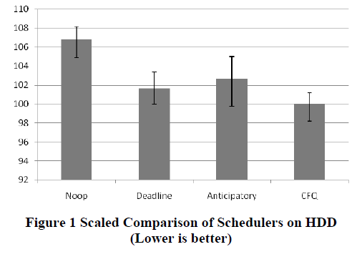

Slide 11
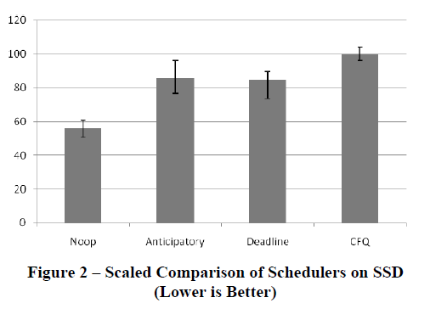

Slide 12
FLASH DRIVE CHARACTERISTICS
The three drives we studied are:
Transcend TS16GSSD25-
S 16GB drive, Memoright GT 32GB drive and the Samsung
MCBQE32G8MPP 32GB drive.

Slide 13
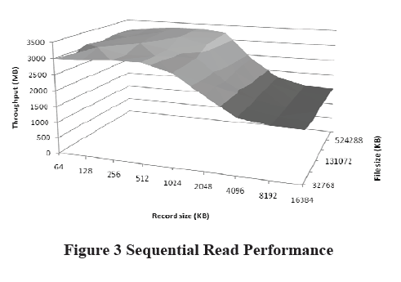
Figure 3 shows a surface curve of the sequential read
performance of the flash drive.
Read performance appears to be unaffected by file size.
but appears to degrade slightly as more data is requested to be read.

Slide 14
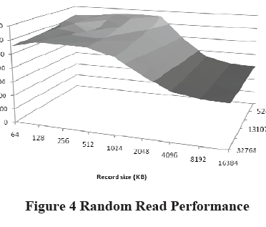
performance appears to be nearly the same.
No surprise: no moving parts .so there should be no seek time, and thus, no difference between sequential and random operations.

Slide 15
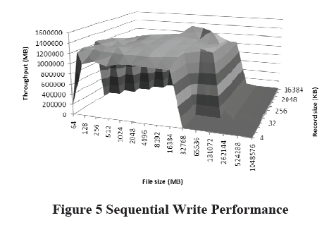
The precipitous drop that occurs once the file size exceeds 512MB.
The drive’s performance becomes the major bottleneck.
We just notice after 512 MB.

Slide 16
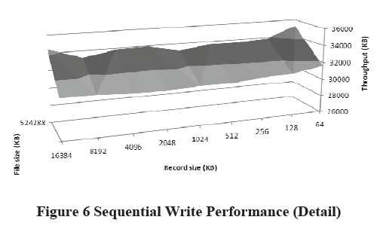
In Figure 6, we see that once the RAM caching effect has
been nullified, the drive performs its writes in the 30MB/s
range across all record sizes.

Slide 17
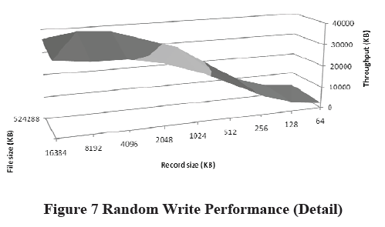
Random writes experience a severe drop in performance as the record size gets smaller.

Slide 18
Flash-specific performance tests
To determine the size of the flash a series of stride writing tests has been developed.
The strided write tests are structured so that the process will write a small amount of data (4k in our case), seek forward a fixed amount, write another small amount of data, seek forward a fixed amount, write again, and so forth.

Slide 19
If the latency peaks occur at fixed intervals independently of the amount of data written, we can assume that there is some boundary mechanism that
triggers when a specific offset is crossed.
If for varying strides, the latency peaks occur only after a set amount of data has been written, we can conclude that it is a buffering or caching bottleneck.

Slide 20
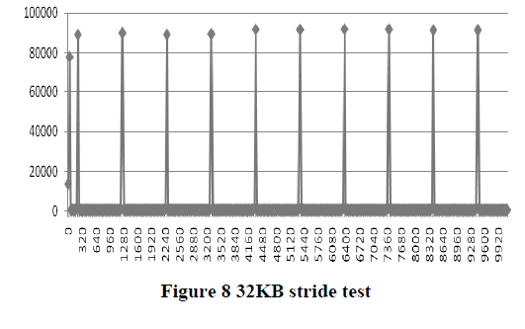

Slide 21
the latency peaks occur regularly every 1024KB offset, or after 128KB of data has been written in total.
Either there is a characteristic of the drive that causes a peak after each 1MB page has been written or there is a 128KB buffer at some point in the pipeline that is being filled and must be flushed periodically.

Slide 22
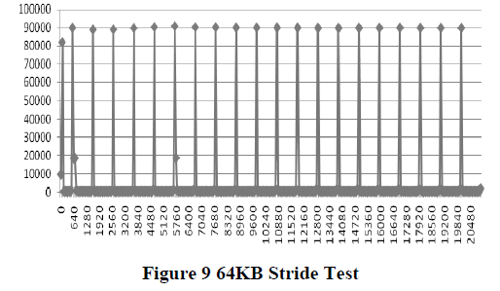

Slide 23
The latency peaks still occur regularly at 1MB intervals.
Compared to the 32KB stride test, we have only written half of the total amount of data as before when the latency peaks occur.
we can say that the peaks do not occur due to the total amount of data written, but rather they occur when we cross into another 1MB block.

Slide 24
NEW SCHEDULER DESIGN
a significant penalty is imposed when new blocks in flash are written to.
Minimize the number of times that the penalty for new block writing is imposed
design a scheduler which will always service requests that are in the same block as the previous request.
We called it ‘block preferential’
our block-preferential scheduler has no directional
seeking preference, like traditional schedulers do.

Slide 25
Terminology
Request x is ‘in front’ of request y, we mean that the starting sector of request x is larger than the ending sector of request y.
Request x to be ‘behind’ request y, the starting sector number of request y must be greater than the ending request number of request x.

Slide 26
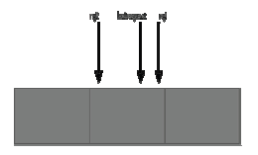
How to Modify Previous Schedulers?
First: Request in front of the previously served request and request behind, lie in the same block as the most recent request, the scheduler will service the largest of the two requests first.

Slide 27
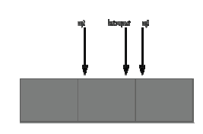
Second: One request which lies in the same block as the most recent request and one which lies in a different page. The scheduler will always service requests in the same block as the request which was most recently serviced.

Slide 28
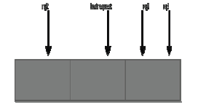
Third: When both the ‘front’ request and the
‘back’ request are in different blocks
If the two requests in front of the recently served request are in the same block, the scheduler will service the ‘front’ requests, since they are in the same block and we can avoid an extra boundary crossing.

Slide 29
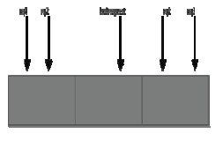
Fourth: Groups of ‘front’ and ‘back’ requests are in contiguous respective blocks, the scheduler simply chooses the largest combination of the two requests to service.

Slide 30
Results
The figure in next slide shows Iozone sequential write performance results on different schedulers including new developed schedulers.
The modifications to the schedulers exhibit a small 2-5% improvement, over their unmodified performance with their new scheduler counterparts

Slide 31
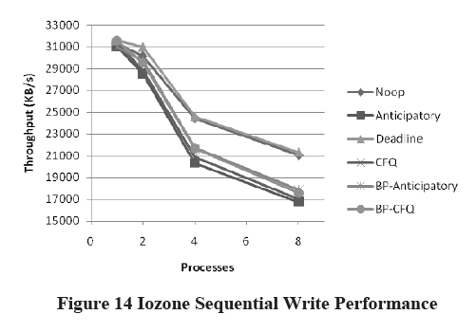

Slide 32
Mixed workload
To evaluate the scheduler under a mixed workload
environment, they ran an Iozone mixed workload test.
This test involved a combination of reads and sequential writes to be performed. For this specific test, the reads occurred twice as often as the writes. The results from this test are shown in next slide.

Slide 33
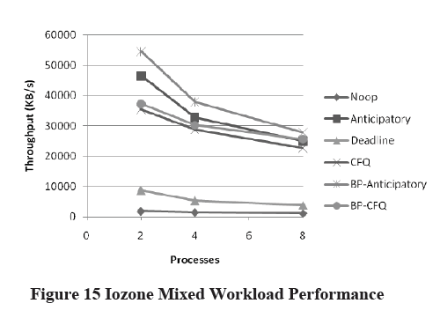

Slide 34
For the mixed workload, we can see that all of the
schedulers which actively address the deceptive idleness
problem perform much better, as we would expect them
too. The modifications to the CFQ scheduler provide a
small gain in this scenario, however, the modifications to
the anticipatory scheduler provide up to 15%
improvement in the mixed workload scenario.

Slide 35
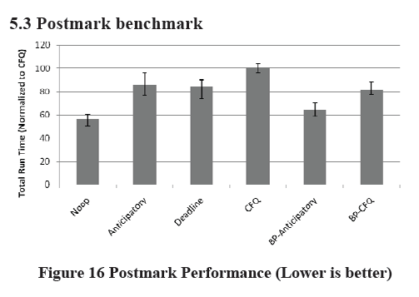
Postmark benchmark

Slide 36
the Postmark benchmark performs
approximately 25% better with a modified anticipatory
scheduler and approximately 18% better with a modified CFQ scheduler, when compared to their respective base schedulers. Neither of the new schedulers achieve the same performance as
the noop scheduler

Slide 37
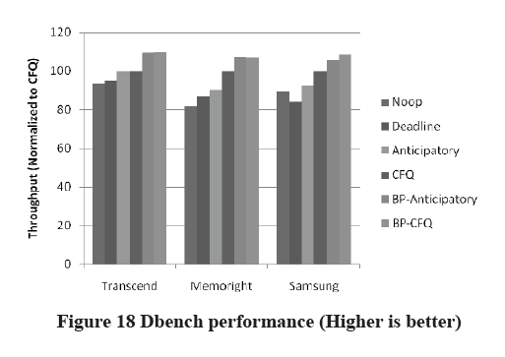
Results for three drives together

Slide 38
Previous figure shows that although new schedulers shows significantly better results than “Anticipatory”, “CFQ” and “Deadline”, but “Noop” still has the best results for this workload.

Slide 39
OLTP Benchmark
The Sysbench OLTP benchmark was created to test
system performance on a real database workload . A
Mysql database is created on the disk to be tested and a
series of complex transactional requests is performed on
it. The results of this benchmark on the different drives
are shown in next slides.

Slide 40
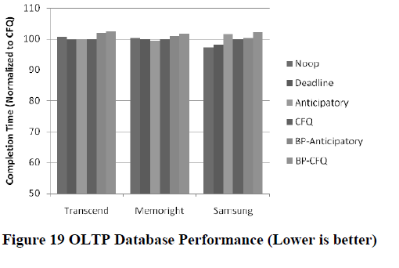

Slide 41
NILFS performance
A very common solution to the random write
problem on solid state devices is the implementation of a log-structured file system. To show that our scheduler is not negatively impacted by the presence of a logstructured file system, we present Dbench bencmark results with the NILFS2 file system in next slide.

Slide 42
