Slide 1

Monte Carlo Simulation
Importance Sampling
DSN-Lab weekly Meeting
Reza Eftekhary

Slide 2

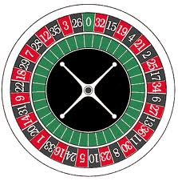
Monte Carlo
Derive name from
  Monte Carlo, Capital of Monaco
  Casinos and Roulette wheels
    Random number Generator

Slide 3
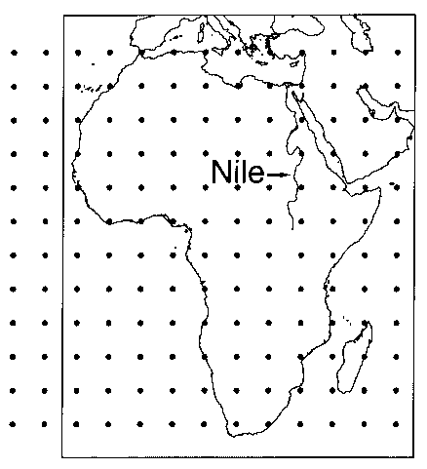
Monte Carlo
Numerical & Approximate solutions for mathematical problems
      Calculating Integral
Statistical sampling experiments
Statistical simulation methods
  sequences of random numbers
    Perform Simulation

Slide 4
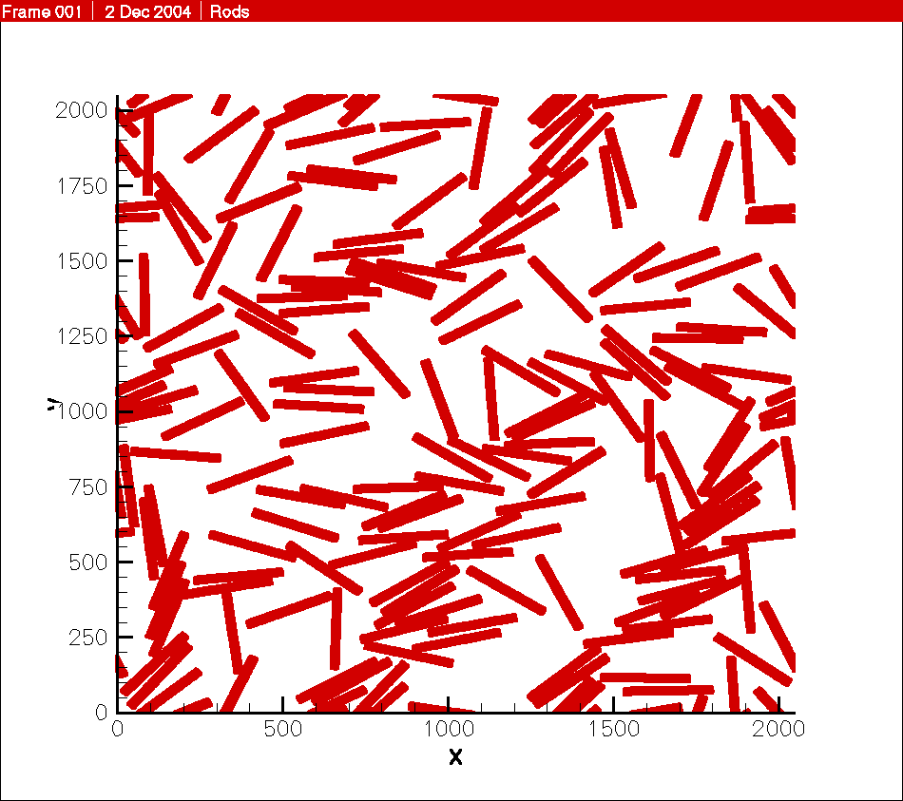
Monte Carlo Usage
Evaluation
  Difficult Integral
  Multi dimensional Integral
  Stochastic process
  Rare event simulation
  ....
C
B
1
0
x
A

Slide 5

Example: Coconut shy
Throwing wooden balls to a row of coconuts
  Probability of hit 0.2

Slide 6
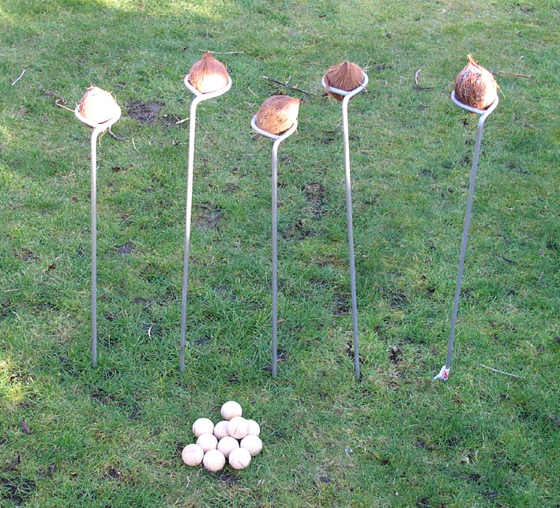
Example: Coconut shy
  Question: probability of hitting even No of ten shots
    Via full experiment
    Via generating random No between 0,1 (MC)

Slide 7
Monte Carlo Methods
Crude Monte Carlo
Acceptance - Rejection Monte Carlo
Stratified Sampling
Importance Sampling

Slide 8
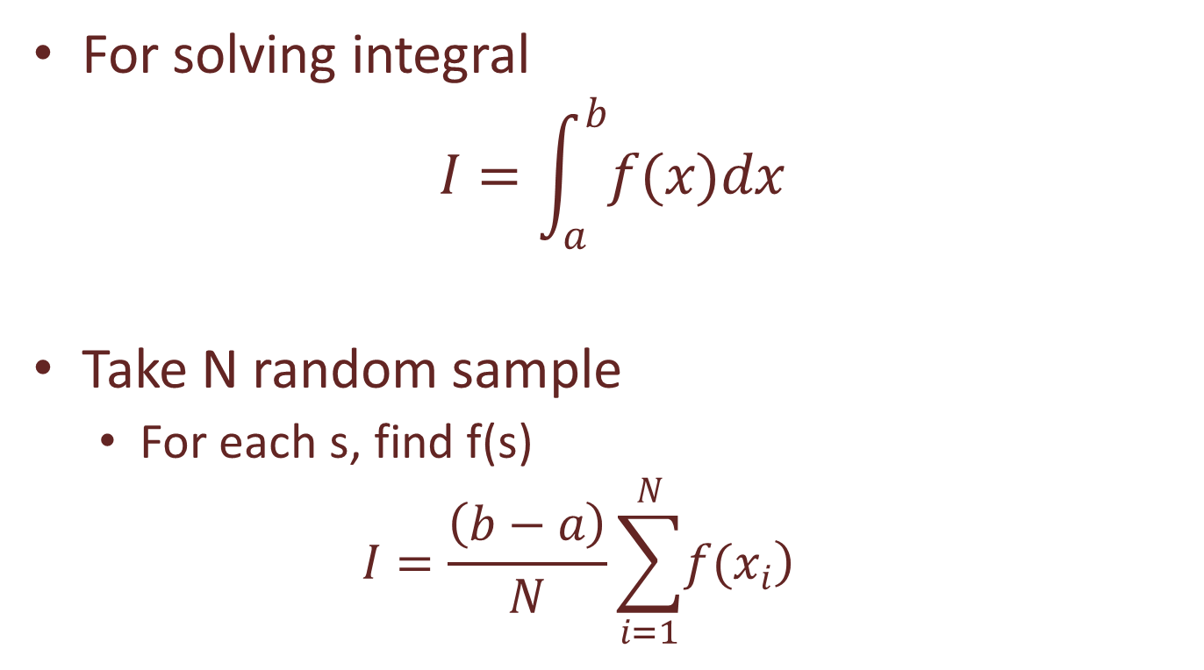
Crude Monte Carlo
For solving integral
$$I=\int_{a}^{b}{f(x)dx}$$
Take N random sample
  For each s, find f(s)
  $$I=\frac{\left(b−a\right)}{N}\sum_{i=1}^{N}{\left.f(x_{i}\right)}$$
n uniformly separated points

Slide 9
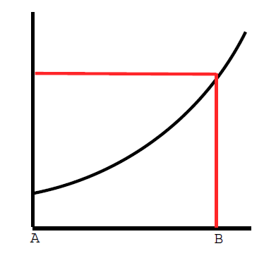
Acceptance - Rejection MC
In (a,b) find function upper limit
Enclose this interval with a rectangle
taking random points
  evaluate points are below the curve or not

Slide 10
Acceptance - Rejection MC
If point is below the curve, treated as a successful sample (K++)
Less accurate

Slide 11
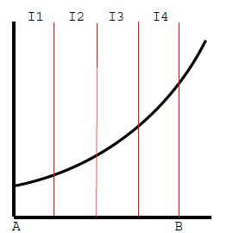
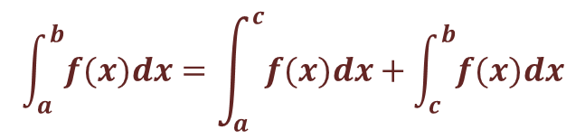
Stratified Sampling
Divide interval into subinterval
  Using crude MC in each subinterval
  Easier variance calculation
$$\int_{a}^{b}{f(x)dx}=\int_{a}^{c}{f(x)dx+\int_{c}^{b}{f(x)dx}}$$

Slide 12
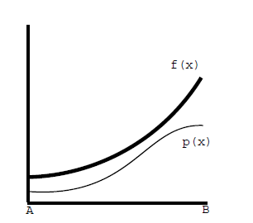
Importance Sampling
Based on impact of each interval
  More samples in area have higher value
    ∑P(x)=1 over (a,b)

Slide 13
Importance Sampling
Taking into account probability of samples
  Counterbalance sampling
    By sampling important parts
  Effective in reducing error of estimation
    P(x): probability distributed function

Slide 14
Importance sampling
IS
  Simulation of rare random events (1/10¹⁰ sample)
  Generates samples have difficult distribution
  Emphasis on variance reduction

Slide 15

Reference
[1] Denny, M., ―Introduction to Importance Sampling in Rare-Event Simulations‖, European Journal of Physics, Vol. 22, pp. 403-411, 2001.
[2] Pengelly, J. (2002). Monte carlo methods. http://www.cs.otago.ac.nz/ cosc453/. Accessed 2009-March-18.
[3] Glynn, P. W. and Iglehart, D. (1989) Importance sampling for stochastic simulations. Management Science, 35, 1367{1392.

