Slide 1
Brief Review of Our Research Work at DSN
Under Supervision of
Dr. Hossein Asadi
Data Storage Network Laboratory
Amirali Shambayati
Mehrnoosh Sameki
Sharif University of technology

Slide 2
What We Cover in This Presentation
Part 1
Project Definition
Part 2
Tools have been used
Looking for appropriate validation ways
Part 3
Our Previous Project at DSN

Slide 3
Project Definition -What is Solid State Drive(SSD)
Uses solid-state memory to store persistent data
viable alternative to traditional magnetic storage media.

Slide 4
Project Definition -What is Solid State Drive(SSD)
Advantages:
Less susceptible to physical shock, quieter , lower access time and latency than HDD.
Same interface as HDD(Advantage for OS developers)

Slide 5
Project Definition -What is Solid State Drive(SSD)
Disadvantages:
Random write speeds, may not have such a clear
advantage in performance(Our major target is optimizing OS to hide this disadvantage)

Slide 6
Project Definition -Technical Steps
Looking for the best Linux IO Scheduler in random write speed
Optimizing the resulted IO scheduler for SSD.

Slide 7
Trace Tools
We have chosen blktrace to evaluate IO schedulers’ Performance

Slide 8
BLKTrace
Ability to see what's going on inside the block I/O
layer
Need to know the specific operations performed
Upon each I/O submitted into the block I/O layer
Who?
Kernel developers in the I/O path:
Block I/O layer, I/O scheduler
Performance analysis engineers

Slide 9
BLKTrace
Emits events for specific operations performed on each I/O entering the block I/O layer

Slide 10
BLKTrace Feature List
Provides detailed block layer information concerning individual I/Os
User­selectable events – can specify filter at event acquisition and/or when formatting output
Supports both “live” and “playback” tracing

Slide 11
BLKTrace User Selectable Events
Request queue entry allocated
Request queue insertion
Request issued to underlying block device
Request queue plug/unplug operation
Request completed
…

Slide 12
BLKTrace and BLKParse
blktrace:
Device configuration, and event
extraction utility
Store events in (long) term storage /pipe to blkparse utility for live tracing
Networking feature to remote events for parsing on another machine
blkparse:
Event formatting utility
Supports textual output

Slide 13
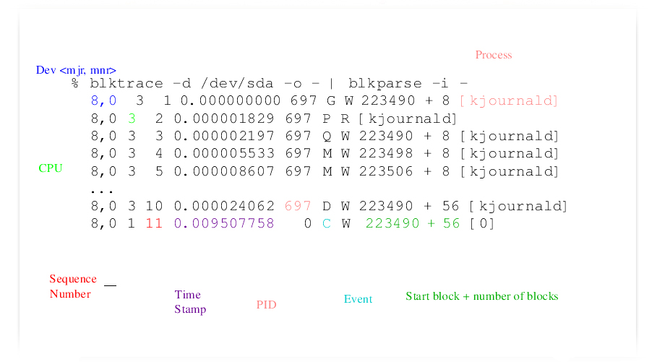

Slide 15
Switch Between Different IO Schedulers in Linux
Show Current Scheduler: # cat /sys/block/sda/queue/scheduler noop anticipatory deadline [cfq]
Change Current Scheduler # echo anticipatory > /sys/block/sda/queue/scheduler

Slide 16
Generating Benchmark Trace
IOZONE has been used as our benchmark

Slide 17
Feeding Disksim by BLKTrace output
Converting BLKTrace output to Disksim default input trace file.
Problem on this way:
As our hard disk size was much bigger than disksim’s SSD model,SSD model couldn’t recognize some of read and write addresses.

Slide 18
Feeding Disksim by BLKTrace output
Solutions to the problem mentioned:
Manipulating SSD model file(modifying block or page sizes) to fit to our hard disk size.(not successful)
Finding the minimum block address.mapping it to zero and mapping other block addresses to the differentiate between minimum block address and itself. .(not successful)
Applying the previous solution on cylinders. .(not successful)
Creating a new partition exactly with the same size as SSD model(using Gparted) and running IOZONE benchmark on this partition. .(not successful)
To be continued ! This problem is still open…

Slide 19
Previous Project: Extracting Simics Trace Output
Simics is a full-system simulator
Simics runs a virtual machine which boots a operating system by itself.
We have used X86 machine image.
We extracted machine’s trace and converted its output to a standard format needed for DSN Lab ‘s simulations.

